Slide 1
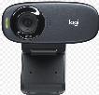





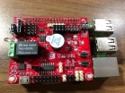



Internet
Web Socket
MQTT
Broker
Web
Server
(Node.js)
Web Socket
Subscription
Publish
Browser
Based app
右邊
上面
Raspberry
Pi

